Slide 1

4 Management Functions
Stakeholders/Decision Makers
BUS024 - Assignment 1
Group 4:
Amaan Chaudhry - a.chaudhry@se21.qmul.ac.uk
Esad Simsek - e.simsek@se21.qmul.ac.uk
Louis Harel - l.harel@se21.qmul.ac.uk
Noor Azhar - n.azhar@se21.qmul.ac.uk
Sun Woo Kim - s.w.kim@se21.qmul.ac.uk
Vasileios Vogiatzis - v.vogiatzis@se20.qmul.ac.uk
Notes:
Hello and welcome. Today we are going to make a presentation about what decision makers and stakeholders, generally the interested parts in a company, need to keep in mind regarding the business environment and why. This is going to be analysed on par with the 4 management functions that we are going to present and evaluate more upon them, at a later stage during the presentation.

Slide 2
Content Table
Question breakdown
4-management functions
Planning analysis & examples
Organising analysis & examples
Leading analysis & examples
Controlling analysis & evaluation
Summary
Sources
3
4
5-6
7-8
9-10
11
12
13-15
Notes:
The presentation is going to be separated into the following parts:
Breakdown of the task and analysis of key terms
A general description of the 4 management functions
Analysis of “Planning” management function accompanied by examples
Analysis of “Organising” management function accompanied by examples
Analysis of “Leading” management function accompanied by examples
Analysis of ”Controlling” management function accompanied by examples
Summary
Sources

Slide 3
Question breakdown
Using the 4 management functions explain what stakeholders and decision makers need to know about the business environment.
Planning, organising, leading and controlling are the main management functions that act as the key-point for every successful business (Umn. edu, 2015).
Every individual from a group of people that has a direct interest in the company and is affected by the decisions of the company and can directly affect the firm (Fernando, 2021).

Slide 4
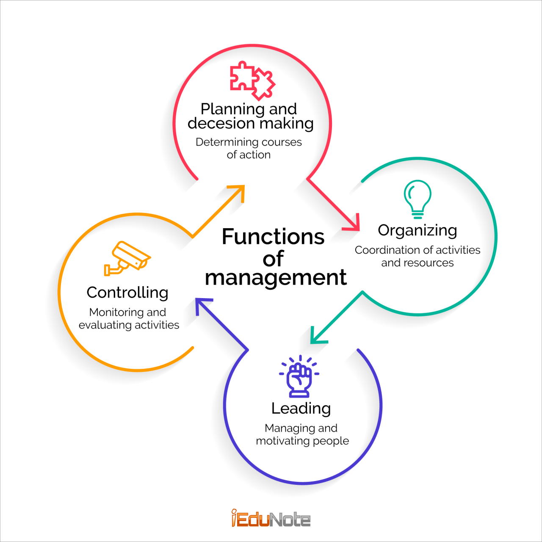
What are the management functions?
All are interconnected and one substitutes the other.
iEduNote, 2018

Slide 5
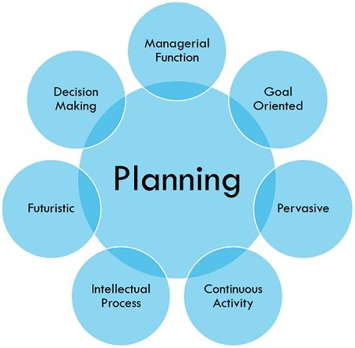
4 Management Functions - Planning
The process of setting objectives and determining in advance exactly how the objectives will be set and met (Jargon, n.d).
The first step in the management sector that clearly sets the short-term tasks and long-term objectives to be met throughout a particular time-frame of the company’s venture (iEduNote, 2018).
Decision makers and stakeholders must assess and evaluate the threats and opportunities in involving in any activity in the market.
Includes potential impacts to the company and analysing the capacity to cope with any potential setbacks.
Business Jargon, (n.d.)

Slide 6
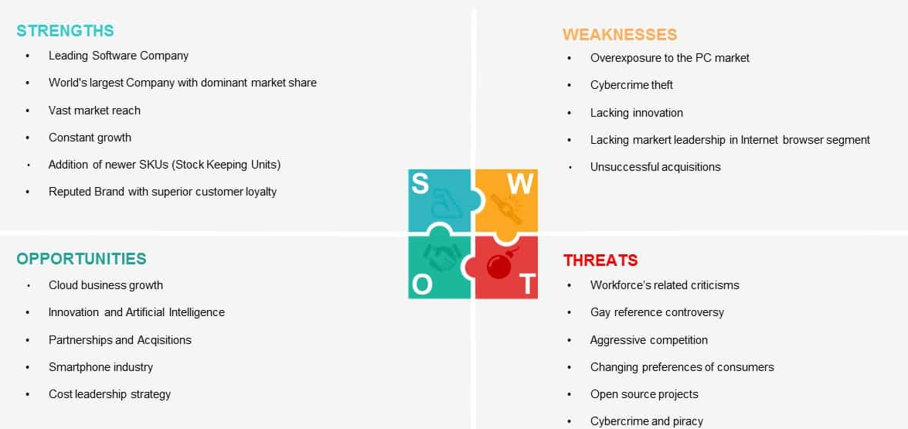
Planning - Example | SWOT Analysis
A strategic planning technique that is used to help organisations to identify the internal Strength and Weaknesses and the external Opportunities and Threats, during the project planning process (Shaw, 2017).
Used by DMs and Stakeholders as if there is any risk, they will no longer hold shares and extract any investments, potentially leading to economic collapse.
Stakeholders with a high interest and power will need to work closely and assess the market to see whether any activity is required for betterment of the company.
Parker, 2021

Slide 7
4 Management Functions - Organising
The management function that involves developing a structure and allocating the human resources with an aim to accomplish the responsibilities previously defined (Umn.edu, 2015).
Organising comes post the planning function, meaning that they are very closely interrelated with each other, exchanging many similar characteristics, all vital for a business success.
Responsibilities (Importance of organising function, n.d)
How to design solutions about the tasks of jobs, including how to carry them out
How to allocate tasks into groups of departments, also known as departemezation
How to design individual jobs to use the maximum available human resources

Slide 8
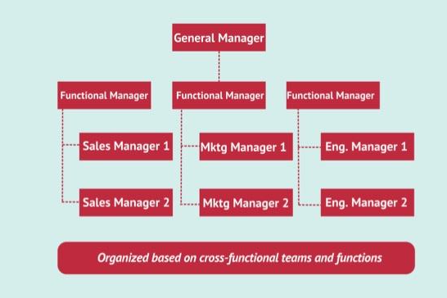
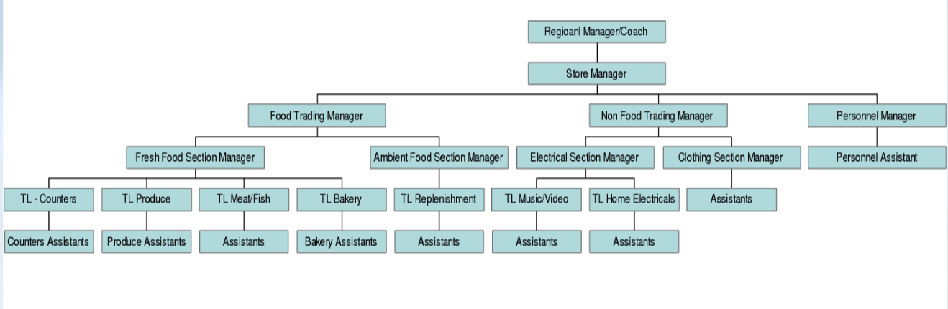
Organising - Example | Hierarchical Structure
Flat hierarchical structure | Google
Cuofano, n.d
More layers/departements → larger the chain of command → great possibility for mistakes
When communicating messages the tasks be clearly defined or wrongdoing might exist.
Maloney, 2015
Vertical hierarchical structure | Tesco

Slide 9
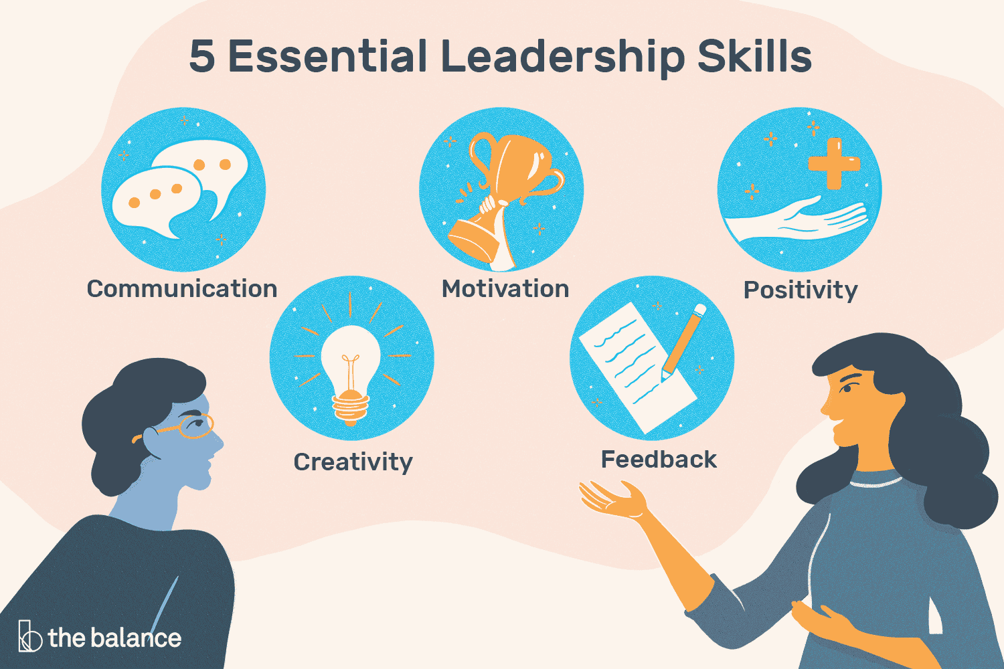
4 Management Functions - Leading
Not only referring within the business environment, leading is the process of stimulating high performance by members of the organisation, else getting members that are part of the organisation onboard with the leader’s plan (Lloyd & Aho, 2020). → Why so important?
Main responsibilities (Fortune, 2018):
Motivating Teammates
Influencing Teammates
Forming Effective groups
Doyle, 2021
Employees will not be motivated according to their needs → more efficient
Absence of openness, accountability, performance, supervision → catastrophic
Notes:
However, as in every team or even smaller groups of individuals, the presence of a figure in the leadership position is a must. Every society requires a leader that will set the rules on how to function and operate in a manner that will be beneficial for the whole society as a whole. Generally leading, not only referring within the business environment, is the process of stimulating high performance by members of the organisation, or in other words getting members that are part of the organisation on board with the leader’s plan. The position of the leader is undeniably one of the most vital ones, in the management function section, but the question is why?
Normally, this means connecting with direct reports or teammates on a personal level. Understanding what drives individuals within the team allows a manager to design strategies around motivating, incentivising, mobilising, and arousing a desire to contribute. All these are essential to keep the morale of the employees high and keep up with efficient work outcomes, where in this case the leader individual is forced to provide these.
They can do this in 3 different ways, using 3 different components; Motivating teammates, Influencing teammates and Forming effective groups. Without them the established organization or team is doomed, since the employees will not be motivated according to their needs, and hence try to be more efficient with their work and eventually contribute to help the organisation succeed and excel. Additionally, lacking these virtues, will result in absence of openness, accountability, performance management and supervision that will result in catastrophic consequences for the organisation and its staff.

Slide 10

Leading - Example | Apple - Steve Jobs
Perfect example of a stakeholder who adopted a kind of an autocratic leadership style, the majority of the decisions are controlled by him, with little next no input from the rest of the members (Connley, 2021).
Steve Jobs was the first of his kind to connect the humanities to the sciences, creativity to technology, arts to engineering, making him the leading figure to exist in silicon valley at that time (Isaacson, 2012).
Connley, 2021
Notes:
Example: A figure that is used as a leadership example all across the business environment is “Steve Jobs”. He is the perfect example of an individual who adopted a kind of an autocratic leadership style, the majority of the decisions are controlled by him with little next no input from the rest of the members, managing to create one of the most successful firms on a global scale, from ground zero, with next to no knowledge in the field of computing. At this point CEO’s and leaders from all over the world, in all kinds of industries are trying to emulate his practises.

Slide 11

4 Management Functions - Controlling
Controlling is the process of monitoring and measuring progress and taking corrective action when needed to ensure that all the objectives are achieved (Kolmar, 2021) → not just to controlling people, but total supervision and management of the team/business in general.
Tasks (iEduNote, 2018):
Training Employees
Managing deadlines
Monitor Employees
Evaluate quality of work
Accomplished (iEduNote, 2018):
Performing a series of activities
Measuring the performance
Correcting the deviations
Byrne, 2020

Slide 12
Summary
Stakeholders and decision makers need to keep under close consideration all of the 4 management functions, whether they are CEOs or whether they are just 1 of the 100,000 employees of a multinational company.
These functions provide the beginning and continuation for any successful business in existence.

Slide 13
Sources - 1
Alison Doyle, (2021). Important Leadership Skills for Workplace Success. [online] Available at: https://www.thebalancecareers.com/top-leadership-skills-2063782 [Accessed 6 Nov. 2021]
BBC Bitesize. (n.d.). Hierarchical and flat organisational structures - Organisational structures - Edexcel - GCSE Business Revision - Edexcel. [online] Available at: https://www.bbc.co.uk/bitesize/guides/z6v847h/revision/1 [Accessed 6 Nov. 2021]
Brianna Parker, (2021). Microsoft SWOT Analysis. [online] Available at: https://bstrategyhub.com/swot-analysis-of-microsoft/ [Accessed 6 Nov. 2021]
Business Jargon, (n.d.) Planning [online] Available at: https://businessjargons.com/planning.html [Accessed 6 Nov. 2021]
Courtney Connley, (2021). Steve Jobs’ Former executive assistant on ‘a big misconception’ about Jobs as leader. [online] Available at: https://www.cnbc.com/2021/04/05/steve-jobs-former-executive-assistant-on-a-big-misconception
-about-jobs.html [Accessed 6 Nov. 2021]
Fernando, J. (2021). Stakeholder. [online] Investopedia. Available at: https://www.investopedia.com/terms/s/stakeholder.asp [Accessed 6 Nov. 2021]
Fortune, S. (2018). There’s no leadership without management | Oxford Group. [online] www.oxford-group.com. Available at: https://www.oxford-group.com/insights/theres-no-leadership-without-management [Accessed 6 Nov. 2021]

Slide 14
Sources - 2
Frank Maloney, (2015). Organisational Structure of Tesco and the NHS. [online] Available at: https://prezi.com/4syqsth1pqqa/organisational-structure-of-tesco-and-the-nhs/ [Accessed 6 Nov. 2021]
Gennaro Cuofano, (n.d.). Organizational Structure. [online] Available at: https://fourweekmba.com/google-organizational-structure/ [Accessed 6 Nov. 2021]
Haque, F. (2016). Importance of Leading in Management. [online] The Strategy Watch. Available at: https://www.thestrategywatch.com/importance-of-leading-in-management/ [Accessed 6 Nov. 2021]
iEduNote (2018). 4 Functions of Management Process: Planning, Organizing, Leading, Controlling. [online] iEduNote.com. Available at: https://www.iedunote.com/function-of-management-process [Accessed 6 Nov. 2021]
Importance of Organizing Function. (n.d.). [online] Available at: https://www.kdkce.edu.in/pdf/Organisation_Structure.pdf [Accessed 6 Nov. 2021]
Indeed Editorial Team (2021). What Are the 4 Basic Functions of Management? | Indeed.com. [online] www.indeed.com. Available at: https://www.indeed.com/career-advice/career-development/basic-functions-of-management [Accessed 6 Nov. 2021]

Slide 15
Sources - 3
Jodie Shaw, (2017). How To Complete A Personal SWOT Analysis. [online] Available at: https://medium.com/thrive-global/how-to-complete-a-personal-swot-analysis-2f8769aebd5e [Accessed 6 Nov. 2021]
Jane Byrne, (2020). Advances and challenges in controlling mycotoxins. [online] Available at: https://www.feednavigator.com/Article/2020/09/28/Advances-and-challenges-in-controlling-mycotoxins [Accessed 6 Nov. 2021]
Kolmar, C. (2021). The Four Functions of Management (With Examples) – Zippia. [online] Zippia. Available at: https://www.zippia.com/advice/four-functions-of-management/ [Accessed 6 Nov. 2021].
Lloyd, R. and Aho, W. (2020). Leading. [online] fhsu.pressbooks.pub. Available at: https://fhsu.pressbooks.pub/management/chapter/110/ [Accessed 6 Nov. 2021].
Umn.edu. (2015). 1.5 Planning, Organizing, Leading, and Controlling. [online] Available at: https://open.lib.umn.edu/principlesmanagement/chapter/1-5-planning-organizing-leading-and-controlling-2/ [Accessed 6 Nov. 2021].
Walter Isaacson, (2012). The real leadership lessons of Steve Jobs. [online] Available at: http://tashfeen.pbworks.com/f/Leadership.pdf [Accessed 6 Nov. 2021]

Slide 16
Thank you very much for your attention!

